Slide 1
The Founding of the Bureaucratic Empire
Chapter 3

Slide 2
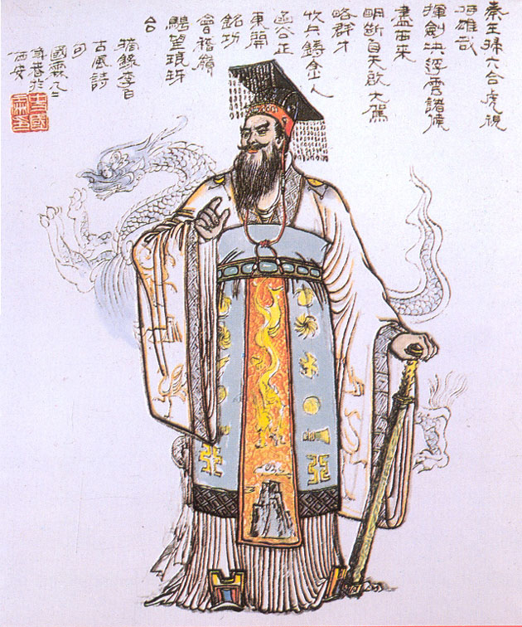
I. The Qin
Video :
First Emperor: The Man Who Made China
Notes:
First Emperor: The Man Who Made China
100 min
2006
Available on Amazon streaming video Prime
(first time to show is Fall 2018 – takes two class periods. Enjoyable docu-drama. Covers up through death of Qin Shihuangdi. Does not cover collapse of Qin and Rise of Han)

Slide 3
Fall of the Qin
Death of Qin Shihuangdi in 210 probably due to elixers
Li Su and the Chief Eunuch engineered the suicide of heir apparent and placed a younger son on the throne
Soon revolt breaks out followed by rebellions throughout the realm.
Notes:
Show Video :
First Emperor: The Man Who Made China
100 min
2006
Available on Amazon streaming video Prime
(first time to show is Fall 2018 – taking two class period. Evaluate whether it is worth two class periods. Looks like enjoyable movie/doc

Slide 4
II. The Han
Two rebel leaders emerge
Xiang Yu (233-202 BC): Chu aristocrat
Liu Bang (247-195 BC): Peasant origin (?)
Liu Bang defeats Xiang; proclaims the Han Dynasty

Slide 5
The Formative Years
Built on Qin foundations; but abolished harsh and intrusive Qin codes
Unable to govern directly; Had to reward old generals and clan members with territory as nearly autonomous fiefs
Leads to problems with dynastic rule

Slide 6
Threats to Dynastic Longevity
Feudalism
Empress’s Clan
Palace Eunuchs
Pastoralists (Barbarian) Threat

Slide 7
Wang Mang (r. 9 bc – 23 ad) usurps throne proclaims the Xin Dynasty
Member of Empress’s Clan, became regent
Usurped throne in 9 bc
Key Reforms
Redistribute land
Well-field system
prohibited slavery
Reinstituted government monopolies
Introduced new currency
Wang Mang met fierce resistance from landlords
Led by Liu Xiu (imperial clan); restored Han dynasty
Notes:
Yes, Wang Mang was indeed related to the imperial family through the empress's clan. He came from the powerful Wang family, which rose to prominence through its ties to the Han imperial court. Wang Mang's aunt, Empress Wang Zhengjun, was the wife of Emperor Yuan (r. 48–33 BCE) and the mother of Emperor Cheng (r. 33–7 BCE). This made Wang Mang an influential figure within the Han court, as the Wang family held significant power during the reigns of these emperors.
As a member of the Empress's clan, Wang Mang was able to climb the political ranks, gaining the title of regent and later serving as the de facto ruler for several young Han emperors before eventually seizing power for himself in 9 CE. His close connection to the imperial family through Empress Wang Zhengjun gave him the legitimacy and influence needed to carry out his ambitions.
The Wang Mang Usurpation refers to a significant event in Chinese history during the transition between the Western Han and Eastern Han dynasties. Wang Mang, originally a powerful official and regent of the Han dynasty, seized the throne in 9 CE, founding his own short-lived dynasty called the Xin Dynasty (9–23 CE). His reign is often considered a "usurpation" because he claimed the Mandate of Heaven and replaced the long-established Han rule with his own.
Background:
Wang Mang was a member of a prominent Han noble family, serving as the regent for the young Han emperor. Over time, he gained power and influence, positioning himself as a reformer and champion of Confucian ideals. When the child emperor died, Wang Mang declared the Han dynasty’s mandate had expired, claiming that he was the rightful ruler.
Key Reforms:
Wang Mang is remembered for his ambitious, but ultimately unsuccessful, reforms. He tried to address social inequality and economic distress through policies that sought to:
Redistribute land to peasants by nationalizing land and limiting the size of private estates.
Abolish slavery in an attempt to create a more egalitarian society.
Introduce new currency systems, which led to confusion and inflation.
While these reforms were inspired by Confucian ideals of fairness, they were poorly executed, creating chaos in the economy and alienating powerful landowners.
Downfall:
Wang Mang's reforms destabilized society, and his rule faced natural disasters like floods and famines, which many saw as signs that he had lost the Mandate of Heaven. Peasant uprisings, notably the Red Eyebrows Rebellion, and external pressures from nomadic tribes eroded his power. In 23 CE, Wang Mang was killed in a rebellion, and the Han dynasty was restored under Liu Xiu, who became the first emperor of the Eastern Han.
Wang Mang's reign is often viewed as a cautionary tale of how drastic reforms can backfire if they are not effectively implemented or if they alienate key segments of society.

Slide 8
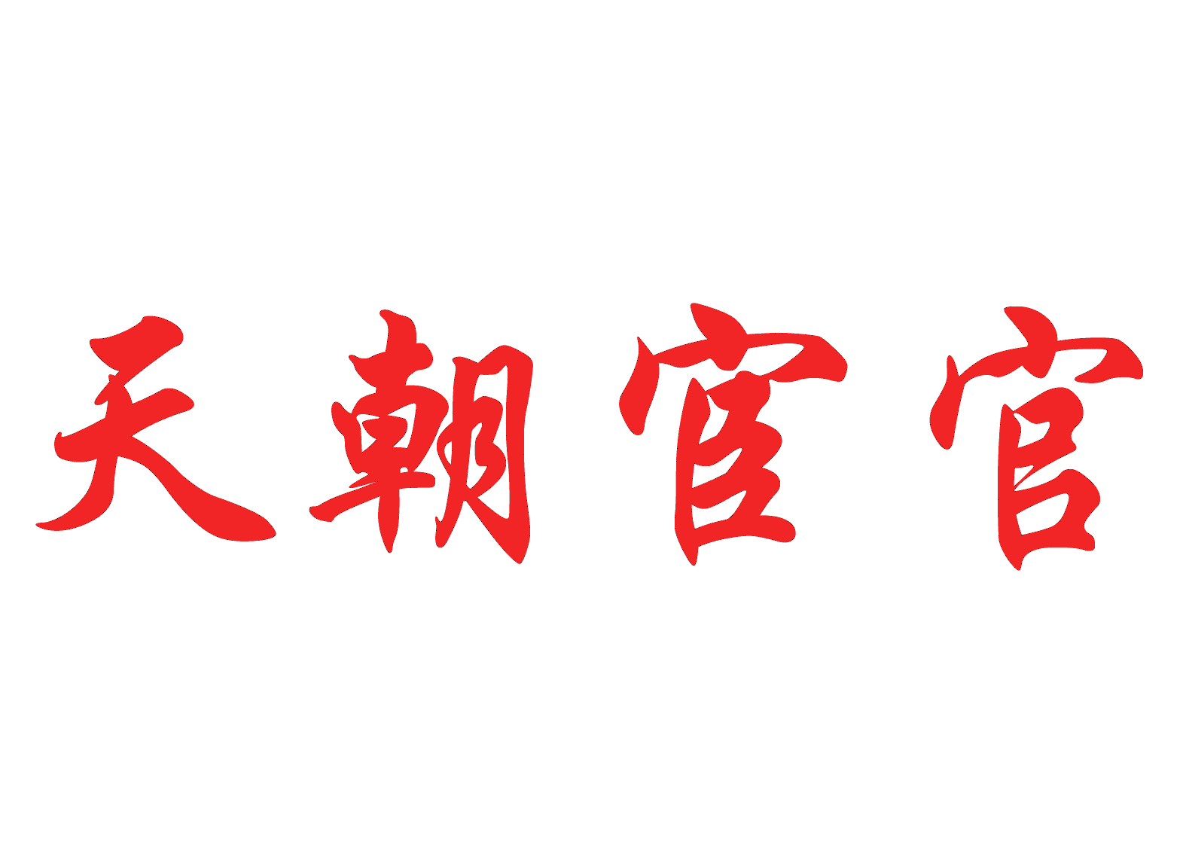
http://www.youtube.com/watch?v=nbgCpmIuaNU
Notes:
http://www.youtube.com/watch?v=nbgCpmIuaNU

Slide 9
Eunuchs of the Han Dynasty
Eunuchs build base of power; wielded tremendous influence though despised by officials
Weak emperors became instruments of eunuchs
124 c.e. Eunuchs stage palace coup; able to place a child on the throne
Great Proscription – Eunuch retaliation against officials who protested eunuch power
Eunuchs seized control of the court
Officials jailed, banned from office, and executed
Lasted 18 years

Slide 10
Borderlands
Emperor Wu adopted expansionist policies: established control over the Southeast (modern-day Vietnam) and colonies on Korean peninsula
Both adopt agrarian peoples adopt Han style government
Pastoralists to the north more resistant
Xiongnu
Pastoral skills converted easily to military skills
Han Response to Pastoralists
Appeasement
Instituted state monopolies to pay for gifts/ marriage alliances
War

Slide 11
Official Support for Confucianism
Emperor Wu and the Rise of Confucianism
Dong Zhongshu’s Contributions
Confucianism as State Ideology
Notes:
During the Han Dynasty (206 BCE – 220 CE), Confucianism evolved from a school of thought into a central ideology that shaped the empire’s political, social, and educational systems. This transformation was particularly significant during the reign of Emperor Wu (r. 141–87 BCE), who is often credited with establishing Confucianism as the official state philosophy. A key figure in this shift was Dong Zhongshu, a Confucian scholar who played a pivotal role in advising the emperor.
1. Emperor Wu and the Rise of Confucianism
When Emperor Wu took the throne, China was experiencing a period of consolidation and expansion. To strengthen imperial authority, he sought an ideology that would unify the empire and legitimize his rule. At this time, Legalism (the dominant philosophy under the Qin Dynasty) was still influential, but it was harsh and rigid. Confucianism, with its emphasis on moral governance, social harmony, and the ruler’s responsibility to the people, provided an attractive alternative.
Dong Zhongshu, a Confucian scholar, was appointed as an advisor to Emperor Wu around 136 BCE. Dong advocated for the supremacy of Confucian ideals in governing the state and believed that these ideals were aligned with the natural order of the universe. His influence on Emperor Wu was profound, leading to a shift in the state’s ideological foundations.
2. Dong Zhongshu’s Contributions
Dong Zhongshu’s most important contribution was his integration of Confucianism with cosmology. He developed the theory of correspondence between Heaven (Tian) and humanity, suggesting that the emperor, as the “Son of Heaven,” had a mandate to rule in accordance with Heaven’s will. If the emperor ruled morally and justly, the natural world would remain in balance. However, if the emperor behaved poorly, disasters like floods, famines, or droughts would occur, signaling Heaven’s displeasure.
Dong Zhongshu’s interpretation of Confucianism emphasized the emperor’s moral obligation to care for his subjects. His ideas were instrumental in convincing Emperor Wu that Confucianism could be a tool for statecraft, blending moral philosophy with political governance.
3. Confucianism as State Ideology
In 136 BCE, Emperor Wu took a crucial step by establishing Confucianism as the state ideology. He ordered the creation of an imperial academy to train future government officials in Confucian principles. This move institutionalized Confucian education, ensuring that scholars who aspired to work in the bureaucracy were well-versed in Confucian texts, such as the Analects and the Five Classics.
The civil service examination system was developed over time as a means of selecting officials based on their knowledge of Confucian philosophy. This system helped ensure that the governing elite were educated in the values of benevolence, propriety, and righteousness, which Confucianism upheld as essential to moral governance.
4. Long-Term Impact
Confucianism’s rise to prominence under Emperor Wu laid the foundation for its dominance in Chinese political and social life for centuries. Confucian virtues such as filial piety, respect for hierarchy, and moral governance became ingrained in the fabric of Chinese society. Confucian thought not only guided political decisions but also influenced family structures, education, and legal codes.
Moreover, Confucianism provided a framework for legitimizing imperial rule. The emperor was portrayed as the moral center of the state, whose virtue and benevolence guaranteed social harmony. This helped solidify the Han Dynasty's rule and shaped the governance of later dynasties.
Conclusion
The official support of Confucianism during the Han Dynasty, particularly under Emperor Wu and the guidance of Dong Zhongshu, marked a turning point in Chinese history. By integrating Confucian principles into the state, the Han Dynasty created a lasting system where moral philosophy and politics were closely intertwined. This move had far-reaching implications for Chinese governance, education, and society, many of which persisted well into modern times.

Slide 12
Han Confucianism
Dong Zhongshu advocates the Mandate of Heaven, i.e., emperor legitimacy contingent on moral virtue
Natural disasters signs of Heavens displeasure
Imperial System
Establishment of Imperial Academy to train government officials in Confucian texts
Early beginnings of civil service system based on merit
Confucian virtues become foundation of state
Confucian classics kept safe or memorized by former scholars
The Five Classics
Book of Changes
Book of Documents
Book of Poetry
Spring and Autumn Annals
Book of Rites

Slide 13
Sima Qian and the Records of the Grand Historian
Sima Qian ( c. 145-86 BC), China's most renowned historian
Background
Born into a prominent family, father was Sima Tan – Grand Historian of Han Court
Promised to finish his fathers work to write complete history of China
Defended a disgraced general; sentenced to castration
Records of the Grand Historian (Shiji), comprehensive history of China from mythological origins to Sima Qian's own day
Notable for its structure
Noted for truth-telling and objectivity
Notes:
Sima Qian (c. 145–86 BCE) is one of China’s most renowned historians, best known for his monumental work, the Records of the Grand Historian (Shiji). This text, often regarded as the first comprehensive history of China, profoundly influenced the development of historiography in China and beyond.
Background of Sima Qian
Sima Qian was born during the Han Dynasty, into a family with a strong tradition of scholarship. His father, Sima Tan, was the Grand Historian of the Han court, a position responsible for keeping official records of the state. Before his father’s death, Sima Qian promised to continue his work and complete a history of China from the earliest times to the present. This project became his life’s mission.
Sima Qian’s career took a dramatic turn when he defended a disgraced general, Li Ling, who had been accused of treason after a military defeat. For his defense of Li Ling, Sima Qian was sentenced to castration, a punishment he chose over suicide in order to finish his work. Despite the personal suffering he endured, Sima Qian remained committed to his historical project, and the result was one of the most important texts in Chinese history.
The Records of the Grand Historian (Shiji)
The Shiji, or Records of the Grand Historian, is a comprehensive history of China from its mythical origins to Sima Qian’s own time. Completed around 91 BCE, the work is vast in scope, covering more than 2,000 years of history and containing over 130 chapters.
The text is notable for its structure, which was innovative for its time. Sima Qian divided the work into several sections:
Basic Annals (Benji): Chronological accounts of the reigns of emperors and significant political events.
Tables (Biao): Genealogical and chronological tables that provide an overview of key events and the relationships between important figures.
Treatises (Shu): Essays on various aspects of government, economy, culture, and society, including discussions on the calendar, music, and rituals.
Hereditary Houses (Shijia): Biographies of prominent ruling families, vassal states, and significant historical figures.
Memoirs (Liezhuan): Biographies of notable individuals, including officials, generals, philosophers, and even outlaws, providing a more personal perspective on history.
This innovative structure allowed Sima Qian to present a multi-layered narrative that combined political history with cultural, social, and biographical insights. He did not merely recount events; he also sought to explore the motivations and character of historical figures, offering moral judgments and reflections on human nature.
Sima Qian’s Historical Approach
Sima Qian’s approach to history was grounded in objectivity and inquiry. He valued the importance of truth-telling, often consulting multiple sources and presenting conflicting accounts to give a more balanced view of historical events. He was deeply influenced by Confucian ideals, particularly the belief that history could serve as a moral guide for rulers and the people. By documenting the past, Sima Qian hoped to preserve lessons that would inform the future.
One of the distinctive features of Sima Qian’s work was his biographical style. In the Memoirs section, he focused on individuals, portraying them with vivid detail and attention to their personal experiences. This approach humanized history and allowed for a deeper understanding of how personal virtues and flaws influenced political events.
Legacy and Influence
The Records of the Grand Historian set the standard for historical writing in China for centuries. Later historians, such as Ban Gu, author of the Book of Han (Hanshu), were heavily influenced by Sima Qian’s method of organizing history and his blend of annals and biography. The Shiji became a model for dynastic histories that followed, known as the “Twenty-Four Histories,” which chronicled China’s imperial past.
Sima Qian’s work transcended its time and had an enduring impact on Chinese culture, shaping how history was recorded, interpreted, and understood. His commitment to accuracy, moral reflection, and the role of the historian as a preserver of truth made the Shiji not only a historical record but also a work of profound literary and philosophical importance.
Conclusion
Sima Qian’s Records of the Grand Historian represents a watershed moment in Chinese historiography. His innovative structure, focus on biography, and moral reflections shaped Chinese historical writing for millennia. Despite personal hardship, Sima Qian’s dedication to his craft ensured that the Shiji became one of the most influential texts in Chinese history, leaving a legacy that has stood the test of time.

Slide 14
Intellectual Movements
Philosophy
Classic of Changes (Yi jing)
Yin/Yang
Five Agents

Slide 15
Sima Qian and the Records of the Grand Historian
Previous histories consisted primarily of court chronicles
History used to support and argument
Sima Qian attempts to write a complete history of the past
Angered the Emperor and was castrated; refused to commit suicide so as to complete his project
Believed in writing authenitic history by examining records, visiting locations, and interviewing participants
History becomes known as Records of the Grand Historian

Slide 16
I Qing

Slide 17
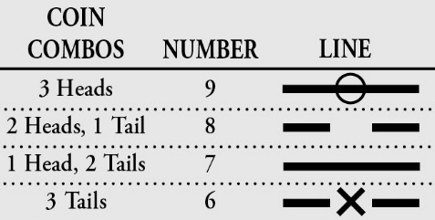
I Qing
https://divination.com/how-to-consult-the-i-ching/
Notes:
https://divination.com/how-to-consult-the-i-ching/

Slide 18
Changes in Political Economy
Increasing tenancy and peasant immiseration
Increasing power of landlords

Slide 19
Later or Eastern Han
Liu Xiu overthrows Wang Mang; moves capital to Luoyang in the the East.
More than half population now tenant farmers, large manors dominate China’s economic scene
The Manor System
Lord/vassal and tenants

Slide 20
The Fall of the Han
Dynastic Cycle and Decline
Peasant immiseration spiral
Peasant debt forces peasants to sell land
Increasingly heavy taxation on dwindling number of peasants
Abscond from land; join bandit gangs or open revolt

Slide 21
Major Threats to Han
Taoist Rebellion
Yellow Turbans
Celestial Masters/Five Pecks of Grain
Eunuchs seized control of the court
Proscription / Purges – execution of powerful courtiers and banning others from holding office
Powerful Warlords

